Slide 1
Pro-electrophiles - a previously overlooked class of extractable with protein-reactive potential
Dr. Lejon Martens*
Dr. Steven Watt*
André Stratmann#
*A&M STABTEST GmbH, Kopernikusstrasse 6, 50126 Bergheim, GERMANY
#ASAS Analytische Standards Andre Stratmann Service Labor GmbH, Gottfried-Hagen-Str. 60-62, 51105 Köln, GERMANY
Dr. Steven A. Watt
steven.watt@am-labor.de

Slide 2
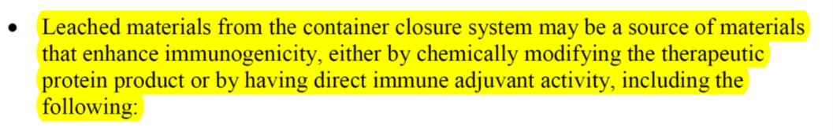
Protein-Reactive Leachables potential elicitors of immune responses
Widely accepted that potentially protein-reactive extractables require special attention.
Covalent modifications may not only render a biopharmaceutical inefficacious but may pose a risk to trigger a patient's immune system.
FDA Guideline for Industry requires to address the potential of leachants to elicit immune responses:

Slide 3
Screening Assays test of total extracts or extractables on protein-reactivity
At the E&L Europe in 2016 we proposed a screening assay to assess total extracts for.
The screening assay has since been published#
Other screening assays have been proposed since, with different surrogate molecules (small molecules e.g., Glutathione, peptides and smaller proteins), offering free thiols and amines as reaction partners.
Many of A&M´s clients use this assay to assess protein-reactivity of their primary packaging extracts.
#R. Haep et.al. Pharm.Ind. 2018, 80 (1), 104-144

Slide 4
Glutathione Screening Assay short recap of the assay proposed at the 2016 event
We chose Glutathione: similar functional groups as in proteins, offers free thiols and amines temperature stable (can be added to the extraction experiment).
The free thiol being the more reactive group.
Different model extractables were tested for proof of principle:
Acrylates:
Bisphenol A diglycidyl ether
Formaldehyde
Allylbromide → as model substance for rubber oligomers
GSH

Slide 5
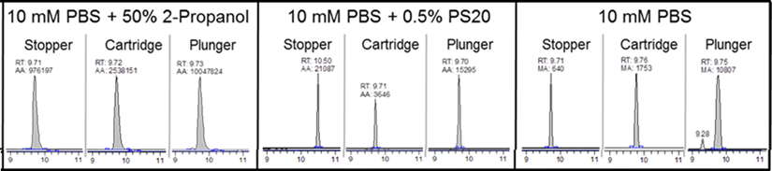
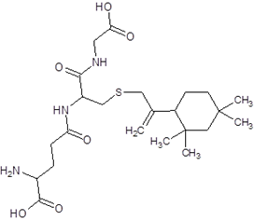
Screening Assay on Rubber Stoppers
A proof-of-principle study on different rubber stoppers
The setup was tested with different rubber stoppers with extraction media with increasing organic solvent content.
Ion trace of a Glutathione-C13-Rubber-Oligomer conjugate
These experiments indicated, that the screening assay works well and that the LC-MS method can be used to screen and detect even low-level conjugation products.

Slide 6
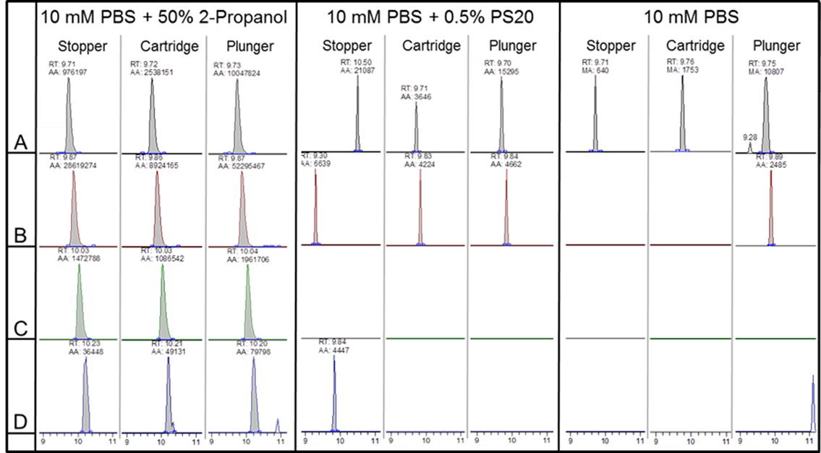
Screening Assay on Rubber Stoppers additional finding of these rubber stopper experiment
In addition to the C13-robber oligomer conjugate we also found conjugated with additions of 32amu (Sulfur).
RT:9.71
AA:976197
RT:9.87
AA:26619274
RT:10.03
AA:1472788
RT:10.23
AA:36448
XIC
XIC
XIC
XIC
S
G-S-C13
G-S-S-C13
G-S-S-S-C13
G-S-S-S-S-C13
486.26 m/z
518.24 m/z
550.21 m/z
582.18 m/z
+32amu
+32amu
+32amu
Experiments with potassium polysulfide indicate, that polysufidic compounds like vulcanizing agents may cause this phenomenon. – They might even attack disulfide-bonds?

Slide 7
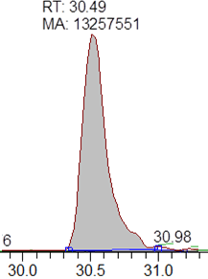
Assay with a Full-Lenght Protein human serum albumin treated with purified C13-rubber-oligomer#
HSA peptide with C13-rubber oligomer adduct.
ALVLIA FAQYLQQCPF EDHVK
The rubber-oligomer could only be identified with the peptide carrying the cystine with the free thiol group.
Formulation components with free thiol groups may act as scavengers for reactive impurities.
#provided by ASAS Analytische Standards Andre Stratmann Service Labor GmbH

Slide 8
The Assay Identifies Electrophiles as expected the assay only revealed electrophilic extractables
Screening assays, such as the one described previously, will only identify potential leachables, which are reactive (e.g. electrophilic) during the extraction experiment.
What about potential leachables, which will become reactive during aging, e.g. by oxidative processes?
Compounds like these will be readily overlooked in a standard screening assays.
In the following, we want to propose a screening assay for potential leachables, which takes oxidative aging processes into account.
A screening assay for “pro-electrophiles”!

Slide 9
Accelerated Aging of Extracts electrochemical activation of potential leachables
The principle of oxidative aging was proposed by Uwe Karst´s group to study protein-reactivity of CYP-activated drug substances*.
The same approach could be used to study potential protein-reactivity of compounds that are considered non-reactive.
Which compounds present in rubber- or plastic formulations are considered as non-reactive?
Anti-oxidants!?
#W. Lohmann et.al. Anal.Chem. 2008, 80, 9714-9719.

Slide 10
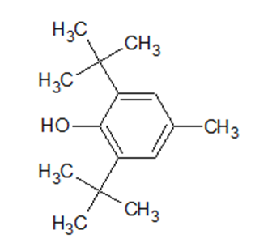
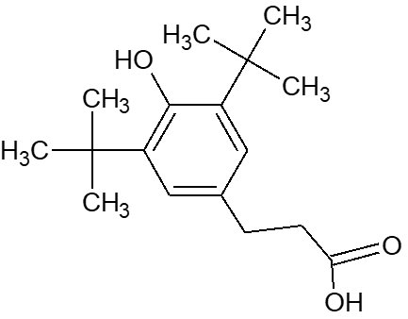
Electrochemical Activation electrochemical activation of model antioxidants
The following model anti-oxidants and their degradation products were used:
Degradation product of Irganox 1076, 1135 and 245
Dibutylhydroxytoluene (BHT)
MW 220.1827 g/mol
DTHP
MW 278.1882 g/mol

Slide 11
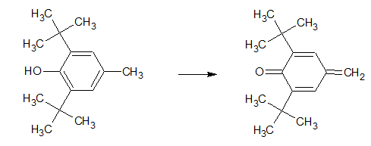
Electrochemical Activation electrochemical activation converts the anti-oxidants to it´s quinonemethide (QM)
700mV
700mV
BHT
MW 220.1827 g/mol
BHT-QM
MW 218.1671 g/mol
DTHP
MW 278.1882 g/mol
DTHP-QM
MW 276.1725 g/mol

Slide 12
Glutathione Assay glutathione was treated with electrochmically activated anti-oxidants
Screening for BHT conjugates with Glutathione
TIC
GSH+ BHT-QM
TIC
GSH+BHT-QM
XIC
XIC
@ 526.2583
@ 526.2583
[m/z]
[m/z]
[min]
[min]
BHT without prior electrochemical activation
BHT converted to QM by electrochemical activation

Slide 13
Glutathione Assay glutathione was treated with electrochmically activated anti-oxidants
Screening for DTHP conjugates with Glutathione
GSH+ DTHP-QM
GSH+DTHP-QM
TIC
TIC
XIC
XIC
@ 584.2643
@ 584.2643
[m/z]
[m/z]
[min]
[min]
DTHP without prior electrochemical activation
DTHP converted to QM by electrochemical activation

Slide 14
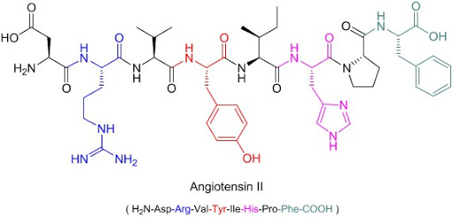
Surrogate Without a Free Thiol angiotensin more closely resembles a protein
Angiotensin II was chosen as a surrogate, because it does not have a free thiol.
This molecule more closely resembles a protein.
It still small enough for easy LC-MS analysis.

Slide 15
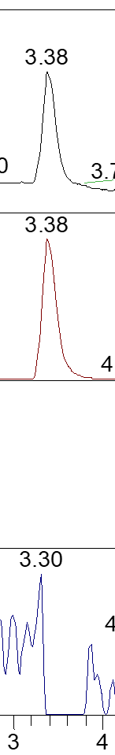
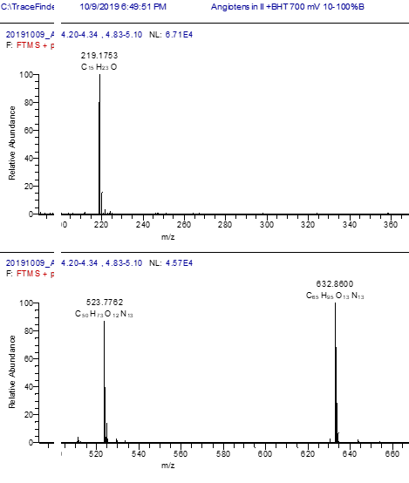
Angiotensin II Screening Assay angiotensin was treated with electrochemically activated BHT
Angio II + BHT-QM
activated
not activated
Angio II
TIC
TIC
+218.17 amu
Full-MS
XIC
XIC
Angiotensin II
BHT-QM
XIC
XIC
Angiotensin II +
BHT-QM
-1046.54 amu
XIC
In-source fragment
(BHT-QM)
XIC
In-source fragmentation

Slide 16
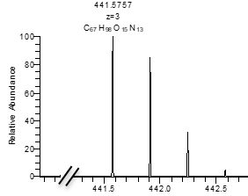
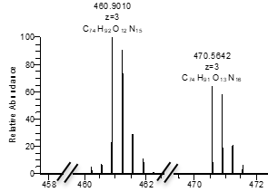
Angiotensin II Screening Assay angiotensin was treated with electrochemically activated DTHP and DPA
Angiotensin II treated with activated DTHP
Angiotensin II treated with activated DPA
TIC
TIC
z=2
XIC
z=2
XIC
z=3
XIC
z=3
XIC
[m/z]
[min]
[m/z]
[min]

Slide 17
Pro-Electrophiles Screening Assay a screening assay taking into account aging processes of potential leachables
Electrochemical activation of extracts can be implemented in the typical extraction workflow.
Glutathione and Angiotensin can be a surrogate molecules. However, Glutathione is easier to analyze and represents a worst-case situation due to the free thiol-group.
The examined antioxidants and their degradation products react with free thiols, if present, but also with primary and secondary amines.
This assay is more indicative in regard to leachable experiments, which use stored (aged) samples.

Slide 18
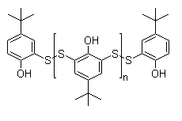
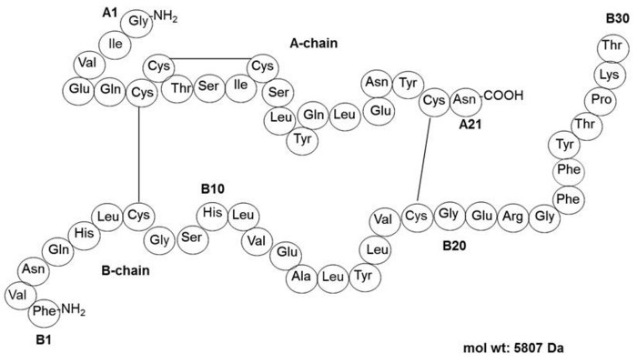
Vulcanizing Agents and Disulfid-Bonds revisiting polysulfidic agents and disulfide-bonds
In the following the vulcanizing agent known as VultacTM was examined.
By treatment of VultacTM with Insulin modifications disulfide-bonds shall be examined
Insulin has two inter- and one intra-chain disulfide-bonds.
[ ]
x
C₃₀H₃₉O₃S₄ (n=1, x=1)
CAS:60303-68-6
Poly-tert-butylphenoldisulfide
Vultac® TB7, Vultac® TB 710

Slide 19
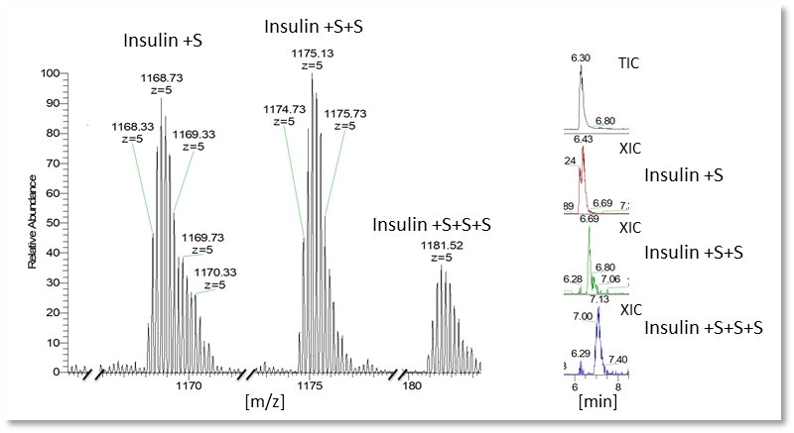
Effect of VultacTM on Insulin
Insulin was treated with VultacTM at a 1:15 molar ratio
1:15 molar ratio, incubated at 55°C for 3h
In the mass spectra we can find insulin and additions of 32amu (Sulfur).
A peptide mass-finger print of the unreduced protein is necessary to evaluate whether the additions of sulfur occur at the disulfide-bonds.

Slide 20

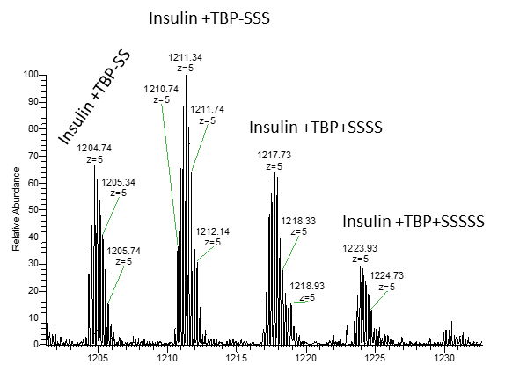
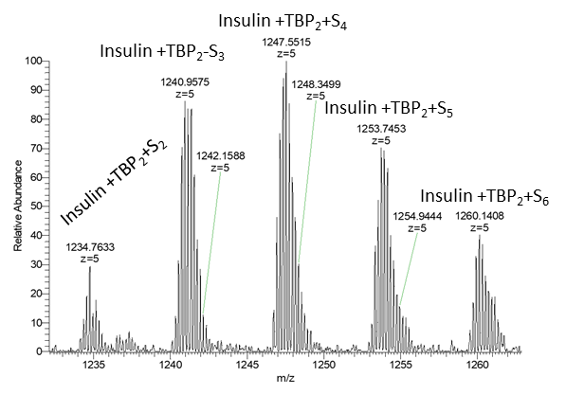
Effect of Vultac on Insulin
Insulin was treated with Vultac at a 1:15 molar ratio
1:15 molar ratio, incubated at 55°C for 3h
TBP-SS
[m/z]
[m/z]
In addition we also observe Insulin with the addition of TBP and multiple sulfurs, as well as two TBP and multiple sulfurs.
The configuration of these additions needs to be investigated

Slide 21
The EPREXTM Case
Vultac has been named as a possible causal agent for the induction red-cell aplasia
In the aftermath of the EPREXTM case, studies suggested that VultacTM may have played a role in causing the induction of red-cell aplasia in some patients#,*.
The elicitation of immune responses, does not require high substance concentrations.
Elicitation may be caused by direct interaction with the host immune system (adjuvant effect) or to modified proteins (e.g. aggregation). Proteins, that are not immune responsive in their natural (native) state.
In the following we investigate the interaction between VultacTM and EPO.
#J.Pang et.al. PDA J. Pharm. Sci. Tech. 2007, 61 (6), 423-432
*B.Sharma et.al. EJHP. 2004, 5, 86-91

Slide 22
Erythropoetin α a glycosylated, globular protein with two intra-chain disulfid-bonds
EPO has a 27 amino acid leader sequence, which is cleaved during processing (in red).
It has three glycosylated asparagines and one serine (in green).
Two intra-chain disulfide-bonds (in blue).
10 20 30 40 50
MGVHECPAWL WLLLSLLSLP LGLPVLGAPP RLICDSRVLE RYLLEAKEAE
70 80 90 100
NITTGCAEHC SLNENITVPD TKVNFYAWKR MEVGQQAVEV WQGLALLSEA
110 120 130 140 150
VLRGQALLVN SSQPWEPLQL HVDKAVSGLR SLTTLLRALG AQKEAISPPD
120 170 170 180
AASAAPLRTI TADTFRKLFR VYSNFLRGKL KLYTGEACRT GDR

Slide 23
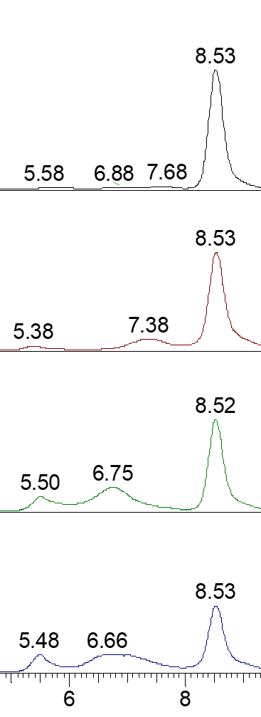
Erythropoetin α Treated with VultacTM test of VultacTM on protein aggreation tested by size-exclusion chromatography
EPO monomer
EPO was incubated at 55°C for 3 h.
Different molar ratios of EPO to VultacTM were used.
Short temperature stress has a minor effect on aggregate formation.
With the addition of VultacTM high molecular weight species appear indicative, of aggregation.
The aggregate formation may be concentration dependent.
EPO @ 55°C for 3h
EPO + Vultac @ 55°C for 3h
(1:1 molar ratio)
aggregates of EPO
EPO + Vultac @ 55°C for 3h
(1:5 molar ratio)
EPO + Vultac @ 55°C for 3h
(1:10 molar ratio)
[min]

Slide 24
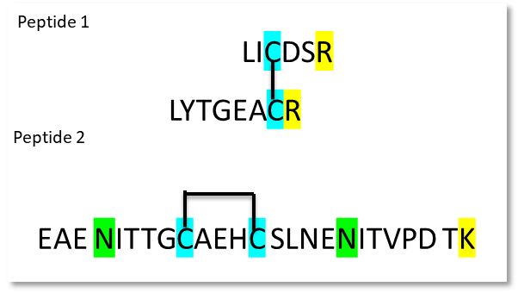
Erythropoetin α Treated with VultacTM peptide mass map analysis to evaluate protein modification
A trypsin digest is performed on the non-reduced protein.
Two peptides with disulfide-bonds can be digested from the protein.
Peptide 2 can give information about the configuration of the conjugation.

Slide 25
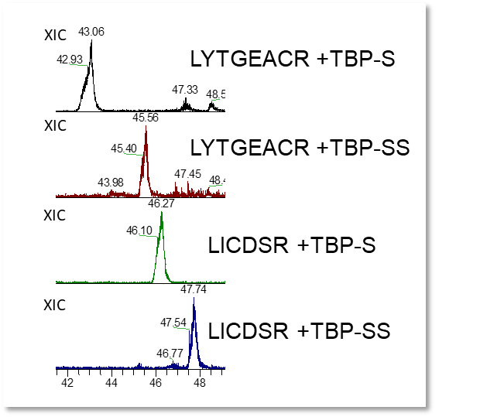
LC-MS of EPO Treated with VultacTM peptide mass map of the two peptides with disulfide-bonds
Peptide 1
LICDSR
EPO was treated with VultacTM at a 1:10 molar ratio and incubated at 55°C for 3 h.
Modified peptide 1 can be found only with disrupted disulfide-bond.
Only the additions of TBP and Sulfur could be identified.
LYTGEACR

Slide 26
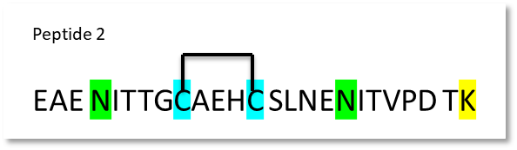
LC-MS of EPO Treated with VultacTM peptide mass map of the two peptides with disulfide-bonds
EPO was treated with Vultat at a 1:10 molar ratio and incubated at 55°C for 3 h.
Only the addition of and Sulfur could be identified.
We proposed that this modified peptides has a closed poly-sulfide-bond formation (closed configuration)
No open TBP-S conjugated could be identified!
XIC
EAE NITTGCAEHC SLNENITVPD TK + S
EAE NITTGCAEHC SLNENITVPD TK + SS
XIC
EAE NITTGCAEHC SLNENITVPD TK + SSS
XIC

Slide 27
HSA a Scavanger human serum albumin has a cystein with a free thiol group
The original EPO was formulated with HSA as a protein stabilizer (was replaced by polysorbate in the second generation EPREXTM formulation).
The idea is, that the free thiol group present in HSA is more reactive than the disulfide-bonds in EPO and may act as a scavenger (especially when formulated in excess).
In the following experiments HSA was added in a 10x molar excess to EPO and VultacTM was added in a 1:1 molar ratio (in regards to EPO). Resembling the first generation EPREXTM formulation and the amount of VultacTM found in previous studies).
The samples were then incubated at 55°C for 3h.

Slide 28
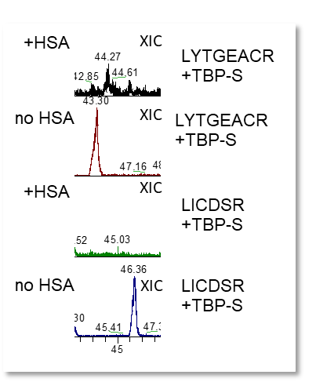
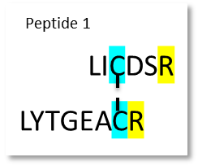
HSA a Scavanger trypsin digest of EPO treated with Vultac with/without HSA
Peptide(s) 1 were monitored for the TBP-S addition in both samples.
Only in samples without HSA the conjugated peptides could be observed.
HSA may actually act as a scavenger for TBP-S

Slide 29
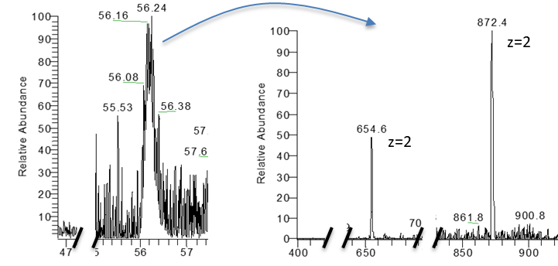
HSA a Scavanger investigation of the HSA-peptide with the free thiol-group
The same EPO + HSA +VultacTM was evaluated in the obtained LC-MS data.
The peptide digested by trypsin has the following sequence:
SH
ALVLIA FAQYLQQCPF EDHVK
+TBP-S
ALVLIA FAQYLQQCPF EDHVK
z=3

Slide 30
EPO is Modified by Vultac and HSA can act as a Scavanger
EPO is readily modified by VultacTM at it´s disulfide-bonds.
The two disulfide-bonds in EPO react differently to VultacTM. Peptide(s) 1: the disulfide-bond opens and the cysteines conjugate with TBP-S_{x}. Peptide 2: the disulfide-bond remains closed and only sulfurs are added.
The reason for this remains to be examined.
HSA added to EPO in a ratio resembling the first generation EPREXTM formulation, exerts a protective function in regard to VultacTM modification.
This is also the in vivo function of HSA; scavenging reactive compounds from the blood stream.

Slide 31




Outsource Stress - Insource Succsess!
André Stratmann (CEO of ASAS): Inventor of the electrochemical activation of pro-electrophiles. Source of E/L-Standards.
Dr. Steven A. Watt (Head BD, A&M STABTEST): Collaborator.

