Slide 1
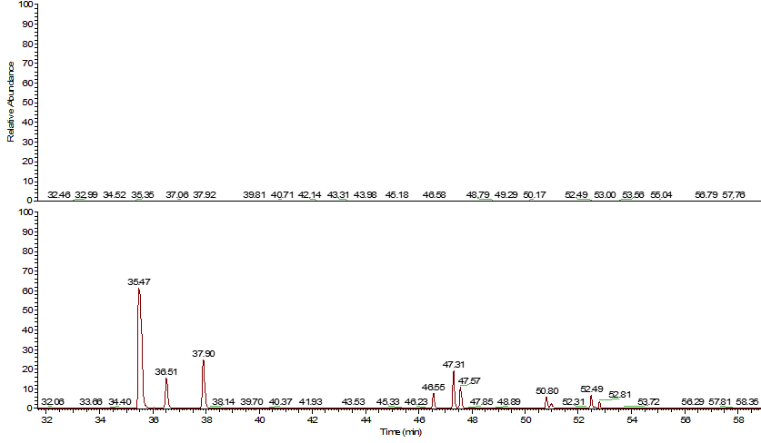
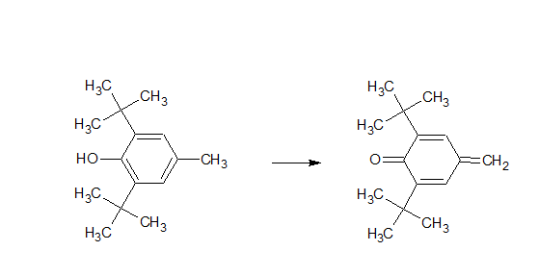
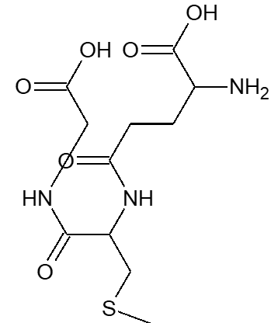
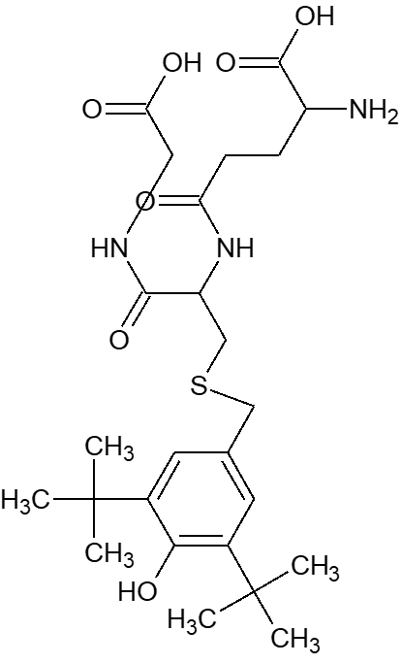
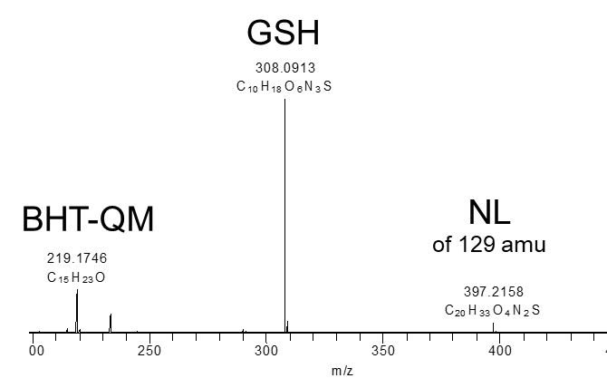
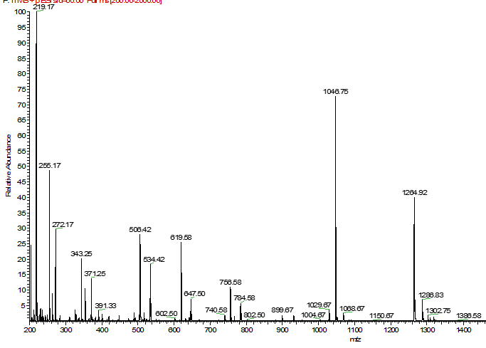
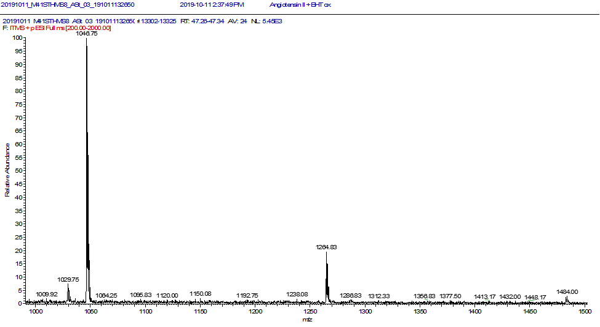
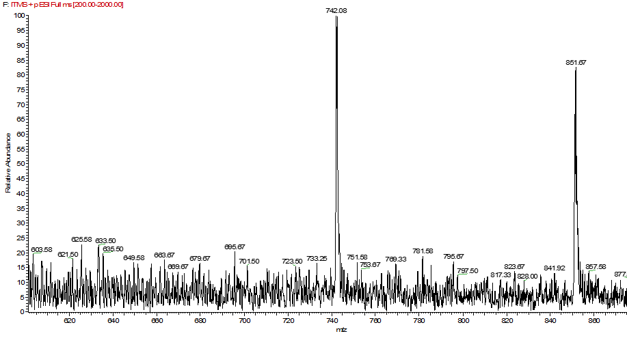
Pro-Electrophiles
- A source of protein-reactive extractable not covered by most screening methods -
André Stratman#, Steven A. Watt*, Lejon Martens*
#ASAS Labor GmbH, Gottfried-Hagen-Str. 60-62, 51105 Cologne
*A&M STABTEST GmbH, Kopernikusstraße 6, 50126 Bergheim
Introduction:
Screening methods to detect electrophilic extractables, which are potentially protein-reactive are well established and are readily used to screen different primary packaging components. These screening methods address protein-reactive extractables, that are either naturally electrophilic or electrophilic at the moment of extraction. However, these approaches are not predictive for extractables, which may become electrophilic as a result of oxidative aging processes.
Here we describe a novel screening approach in which, extracts of primary packaging materials are oxidatively activated to screen for components, that can be converted into potentially protein-reactive electrophiles as a result of aging processes. To simulate oxidative aging, a coulometric cell was used to convert pro-electrophilic compounds in to electrophils. As a model pro-electrophile butylated-hydroxy-toluene (BHT) was used.
Establishing the coulometric conversion of the model pro-electrophil BHT
Therefore, the setup of oxidatively converting extractables and subsequent reaction of these with a model compound was extended to the small, thiol-free peptide Angiotensin II.
To test the oxidative conversion of potentially pro-electrophilic extractables, BHT was treated in a coulometric cell. The activated BHT was then exposed to glutathione (GSH), a model compound used in previous studies, and reaction products were subsequently monitored by LC-MS/MS.
Angiotensin II + BHT
Angiotensin II + activated BHT-quinonemethide
700 mV
+
Peak group 1
Peak group 2
Peak group 3
BHT
H
BHT-quinonemethide
GSH
GSH-BHT Adduct
GSH-BHT-QM Adduct
BHT-QM marker ion @ 291.17 m/z
-BHT-QM
Δ 218.17 amu
-BHT-QM
Δ 218.17 amu
Full MS
MS/MS
Peak group 1
-BHT-QM
Δ 218.17 amu
Peak group 2
of 526.26 m/z
Fig.1: Test of the reaction conditions for the oxidative conversion of pro-electrophile BHT to the electrophilic BHT-quinonemethide. Above: The reaction scheme of the oxidative conversion of BHT in a coulometric cell and the subsquent reaction of BHT-quinonemethide with GSH. Below: The LC-MS/MS analysis of the GSH-BHT Adduct.
-BHT-QM
Δ 109.59 M²⁺
-BHT-QM
Δ 109.59 M²⁺
Fig.2: Reaction of activated BHT-QM with Angio-tensin II. Above: Extracted-ion-Chromatograms (EIC) on the MS/MS trace for the BHT-QM marker ion @ 291.18 m/z. Below: MS/MS spectra of the signals for peak group 1, 2, and 3.
This experiment shows, that the reactions conditions in the coulometric cell are suitable to convert pro-electrophiles to electrophilic compounds capable of reacting with thiol groups in the model GSH.
Under MS/MS conditions the GSH-BHT-QM adduct loses BHT-QM, resulting in a BHT-QM marker fragment of 219.18 m/z. This marker ion may be used to identify modified peptides in full length proteins.
Peak group 3
Using the BHT-QM marker ions was useful to identify BHT-QM modified peptides. Using this approach three peak groups (PG) could be identified: PG1 Angiotensin with one BHT-QM adduct at three distinct locations in the AS sequence; PG2 Angiotensin with two BHT-QM adducts; PG3 with three BHT-QM adducts.
Capability of oxidatively activated electrophiles to react with amines
Conclusion:
Since there are very few free thiols available in therapeutic proteins, the results of GSH-screening assays may not be predictive for drug products in their final container closure systems.
The oxidative activation of pro-electrohiles can be achieved in a coulometric cell. Angiotensin II can be used as a model peptide of identify electrophiles capable of reacting with amines.

